Slide 1
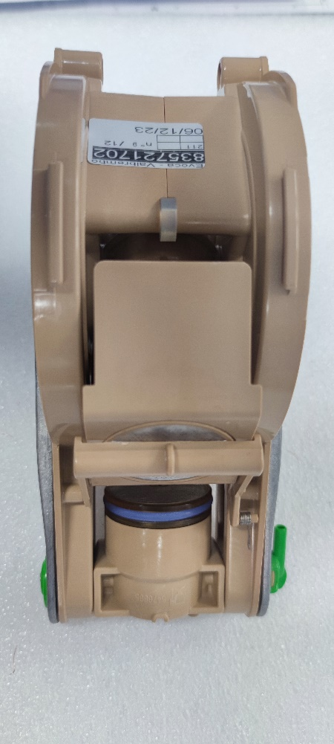
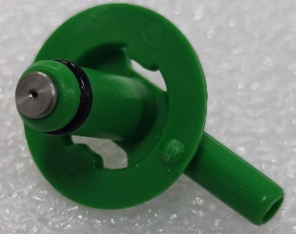
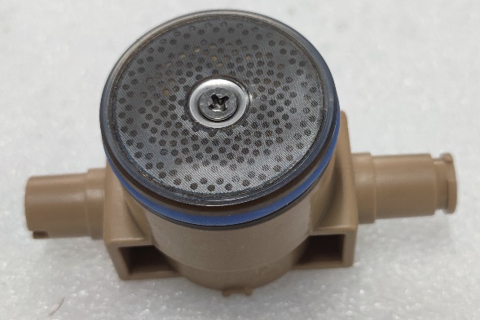
REASON:
Be informed that with the aim to improve our equipment,
MODIFICATIONS:
The following modifications have been made to the Z4000 JDE coffee group:
the restrictor diameter of ES nozzle assembly has been reduced from 0,7 mm to 0,6 mm
Coffee filter Ø42 mm for upper piston has been replaced by coffee microfilter Ø42 mm
1
2
Modified
ES nozzle assembly
Coffee microfilter Ø42 mm
Restrictor diameter
0,6 mm (it was 0,7)
Upper piston
Revision 02
Modified
Z4000 JDE coffee group

Slide 2
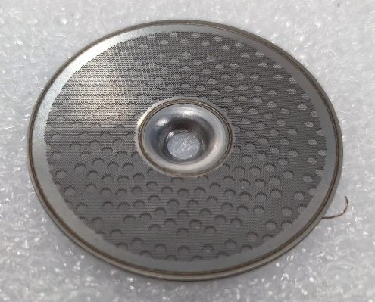
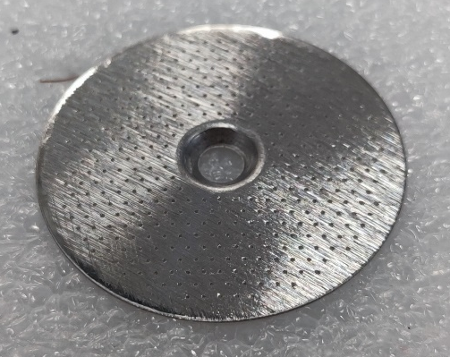
Coffee microfilter Ø42 mm
Spare part code: 265809
Pre-modification coffe filter Ø42 mm
Spare part code: 261755
Modified ES nozzle assembly
(Restrictor diameter 0,6 mm)
Spare part code: 266424
Pre-modification ES nozzle assembly
(Restrictor diameter 0,7 mm)
Spare part code: 261863
Modified Z4000 JDE coffee group
Spare part code: 266423
Pre-modification Z4000 JDE coffee group
Spare part code: 261862
Machines concerned by modification from S/N 34920075.
EXCHANGEABILITY:
Modified parts or assemblies can be used on machines produced before S/N above.
Pre – modification codes will be available while stocks last.

