Slide 1
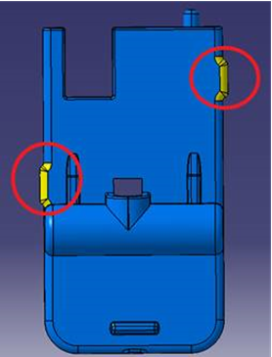
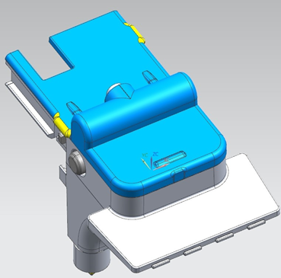
REASON:
Improved positioning of the machine dispenser assembly
MODIFICATIONS:
In order to improve the positioning of the dispenser in the machine, we modified the lid of the cappuccinatore by inserting two mold ribs. We have seen that this modification also improves the coupling between the cappuccinatore and the front of the machine, fixing the remaining cases of lack of cappuccinatore presence signal.
Spare part code CAPPUCCINATORE LID: 265457
Machines concerned by modification from S/N: 9023MGCP012082
EXCHANGEABILITY:
Spare code: 265457

